Slide 1
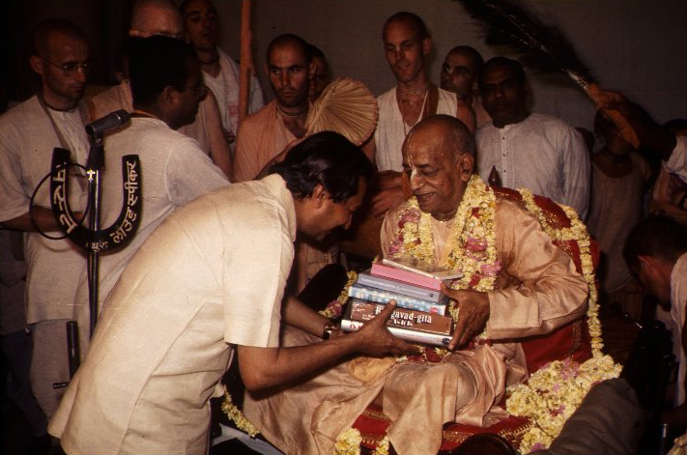
Srila Prabhupad Book Marathon 2012

Slide 4
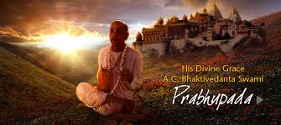
HIGHLIGHTS
Endeavor of all devotees

Slide 5
Highlights
SPECIAL SCORERS AND
MAIN CONTRIBUTORS
ARE

Slide 6
Each one of you

Slide 7
TRANSCENDENTAL BOOK
GODOWN
REPORT

Slide 8
Senior brahmacharis – BUS PARTY: Punjab & Gujarat

Slide 9
Sign up – Its yours
8000 + 4000 = 12000 MB

Slide 10
BT Brahmacharis – Villages : Main focus - School teachers

Slide 11
Giving Knowledge to Teachers

Slide 12
(Amravati)6300 + (Konkan) 5400 = 11,700

Slide 13
Thane congregation 1500 MB

Slide 14
Mothers Sankirtan Party- Miraroad devotees = 2000 MB

Slide 15
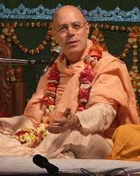
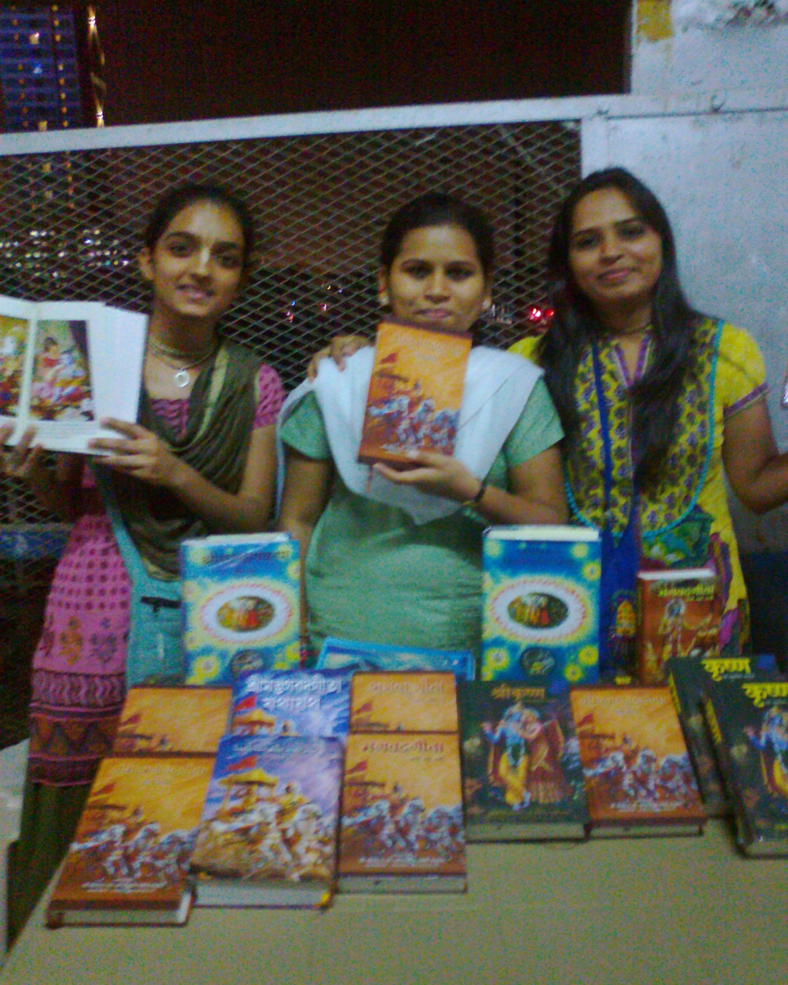
Tamal Krishna Maharaj Group 700 MB

Slide 16
Varishta Vaishnavas

Slide 17
New Mumbai- Vashi, Nerul, Belapur, Kharghar, Panvel = 8000 MB

Slide 18
Talvan Bace – 1900 mahabig

Slide 19
VTA – 1400 books

Slide 20
QUALITIES OF BOOK DISTRIBUTOR

Slide 21
1) Innovative strategies - Damodar bhava p
2) Determination – Tamal krishna maharaj group . (Going ahead inspite of Problems with Railways)
3) Consistency - Mira road devotees
Kanjur marg devotees, Diva-Kalyan
devotees.
4) Patience - Yasoda kumar p (as they didnt get permission for 2 weeks)

Slide 22
5) Intensity – Yogesh chandra p & Jairadhe mataji. (within 3 days husband and wife alone did 1300 mb)
6) confidence - Talvan bace - Pravin (inspite of skepticism from book godown about their results, they did wonderfully well.)
7) Teamwork - Naina m and Advait jivan p (brother of radhika raman p). They did door to door distribution in buildings.
8) Backbone of our score - Gita yajna and Sastra daan Yajna. (i.e Gokulanand P and Kumar Gauranga P)

Slide 23
?

Slide 24
OSMANABAD

Slide 25
MOTARI, ORISSA

Slide 26
MOTARI, ORISSA – EVERY HOUSE

Slide 27
SCORE MULTIPLICATION DAY
Based on inspiration of many congregation devotees

Slide 28
HOW ???????????
1 BHAGAVAD GITA
MANY BHAGAVAD GITA
Charity begins at home

Slide 29
SPONSOR 1 BHAGAVAD GITA
SCORE MULTIPICATION DAY - LAST DAY
EK EK KARKE ANEK
Help in distributing books to villages -
pls meet devotees at Sastra dan table down in courtyard. (10am -11am, 2.30 pm-4.30pm)

Slide 30
SPONSOR MANY !!!!
AGE OLD METHOD ----1st time introduce in modern set up

Slide 31
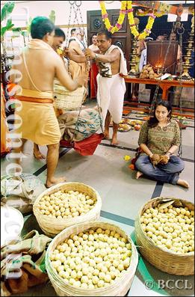
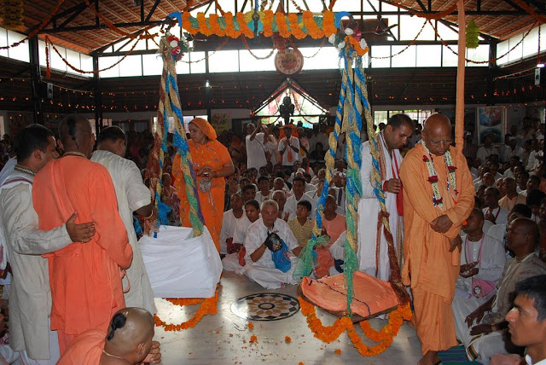
Diff types of Tulabhar from scriptures

Slide 32
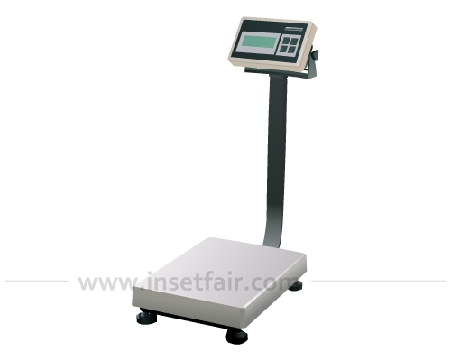
Modern Tula Bhar

Slide 33
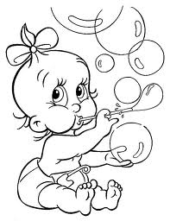
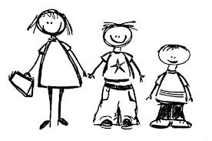
Kids, Children - Tulabhar

Slide 34
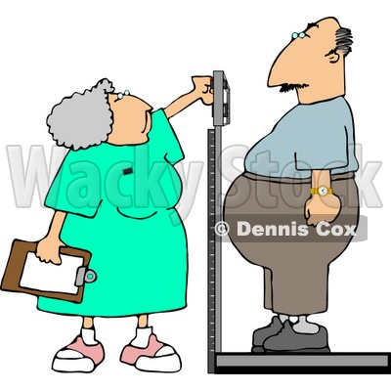
More bigger more better (More chance to serve)

Slide 36
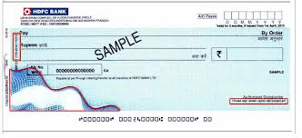
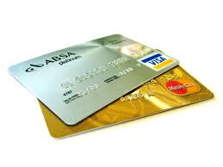

Slide 37
Dedicated in memory of H.G Madhupriya Mataji
INDIVIDUAL BOOK DISTRIBUTION
SASTRA DAN

Slide 38
POWER OF CONGREGATIONAL EFFORT.

