Slide 1
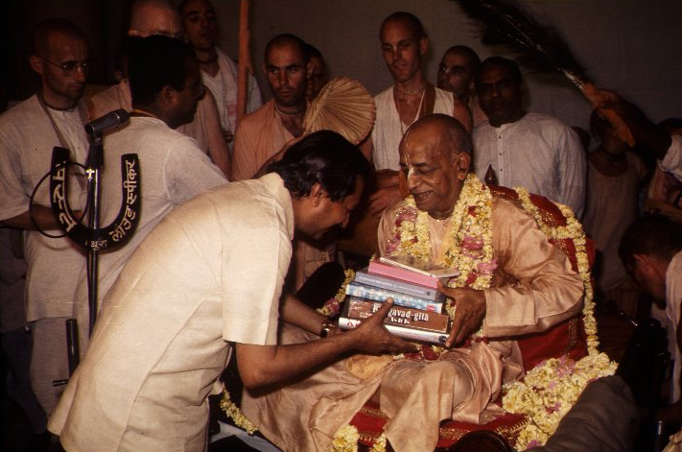
Kaun banega LUCK pati

Slide 4
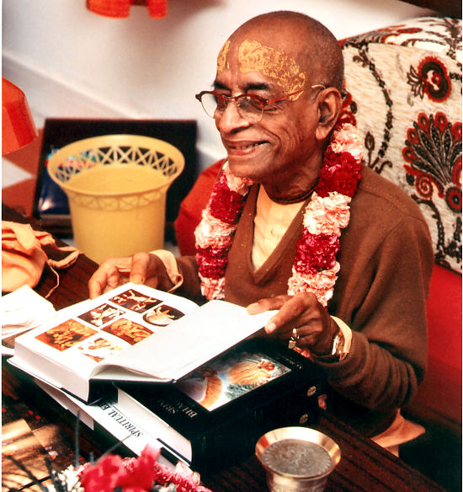
A Happy and Warm Welcome to all

Slide 5
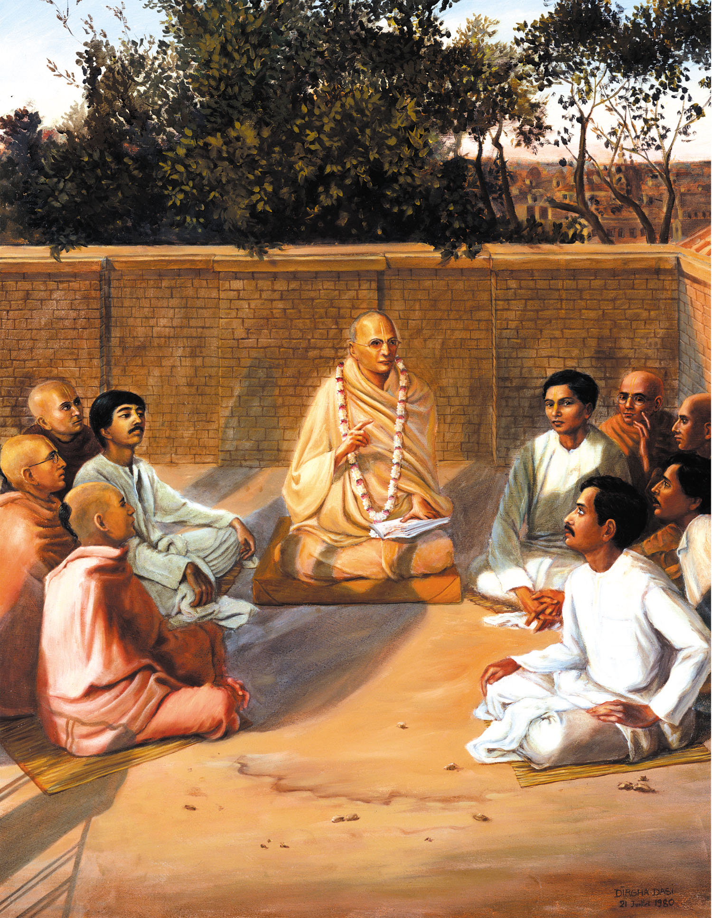

Slide 7
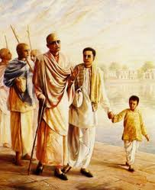
At Radhakunda

Slide 8
jhansi

Slide 11
SP in Loi Bazar ??

Slide 13
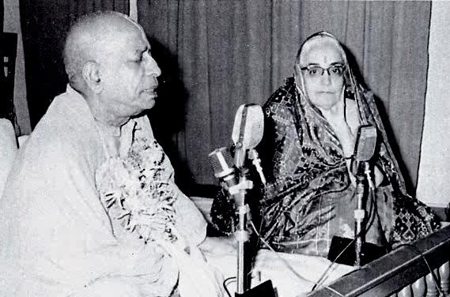

Slide 19
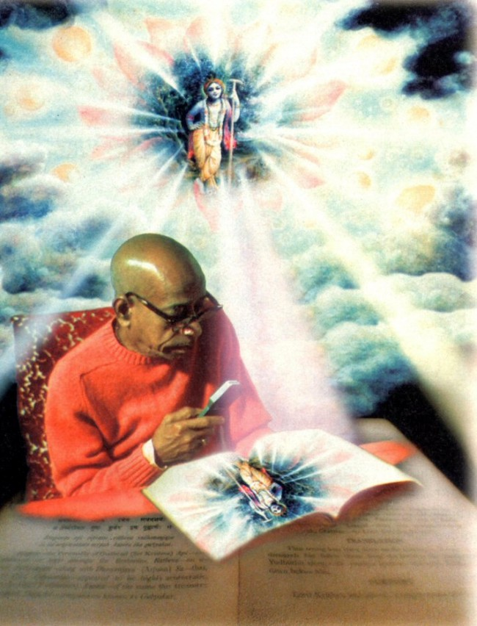
Bhavanand p recollects
= “write few books”.

Slide 20
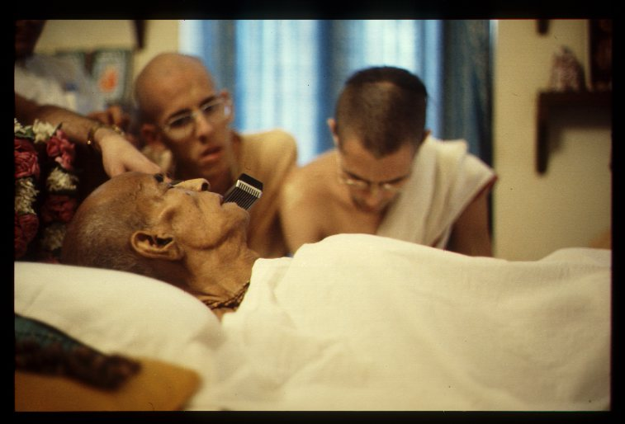
Last days – dictating book purports.

Slide 21
Srila Prabhupad with his books
BEAUTIFUL MOMENTS

Slide 22
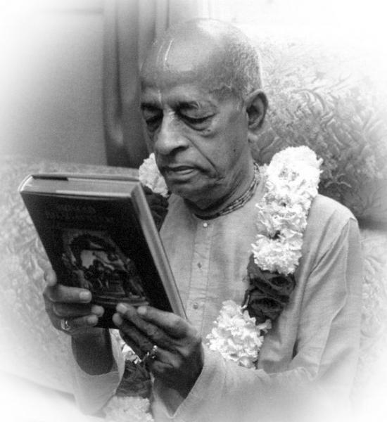
Seeing Prabhupad smile

Slide 23
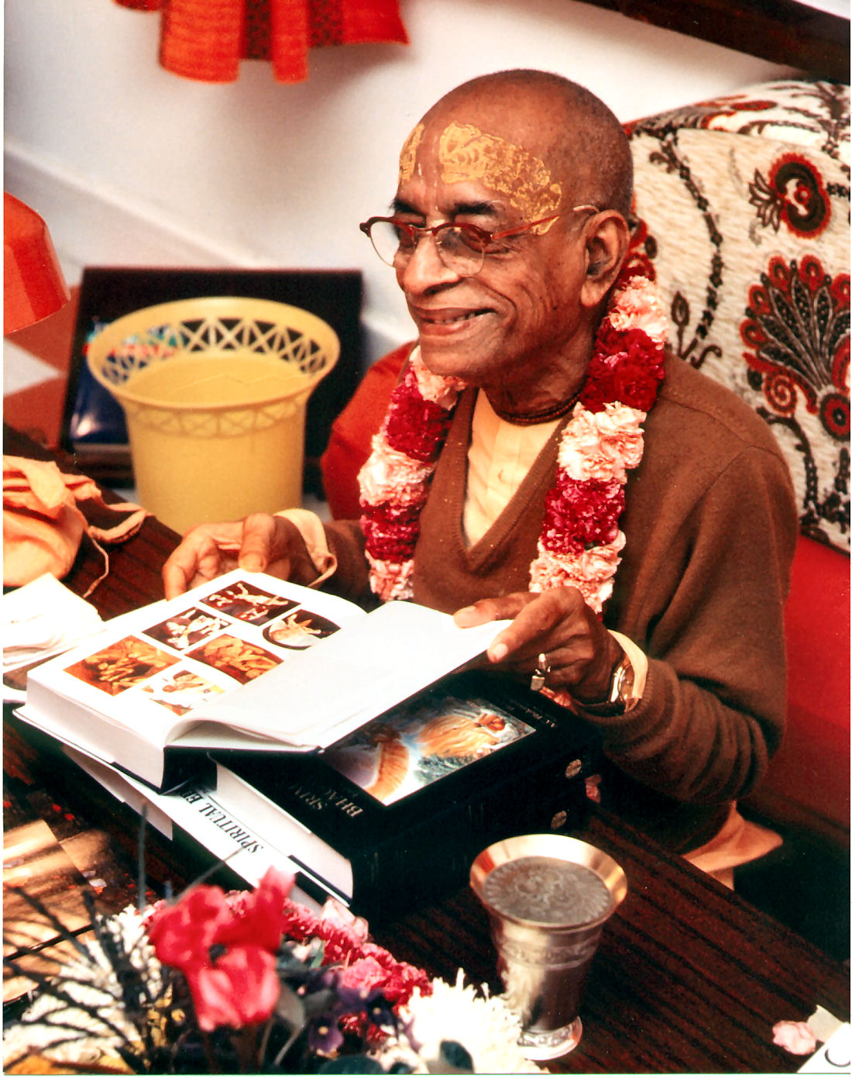
Satisfaction & then Happiness

Slide 25
Ultimate pleasure – An Empire conquered

Slide 28
Reading his own Books

Slide 29
Fresh from print

Slide 30
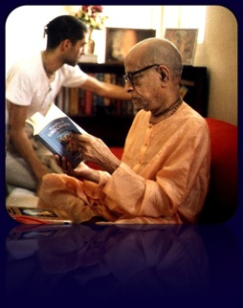

Slide 31
Smile on disciple’s face – “yasya prasadad.. ”

Slide 32
Working hard – Late hours

Slide 33
IF YOU WANT TO PLEASE ME, DISTRIBUTE MY BOOKS

Slide 34
ISKCON CHOWPATTY HIGHLIGHTS

Slide 37
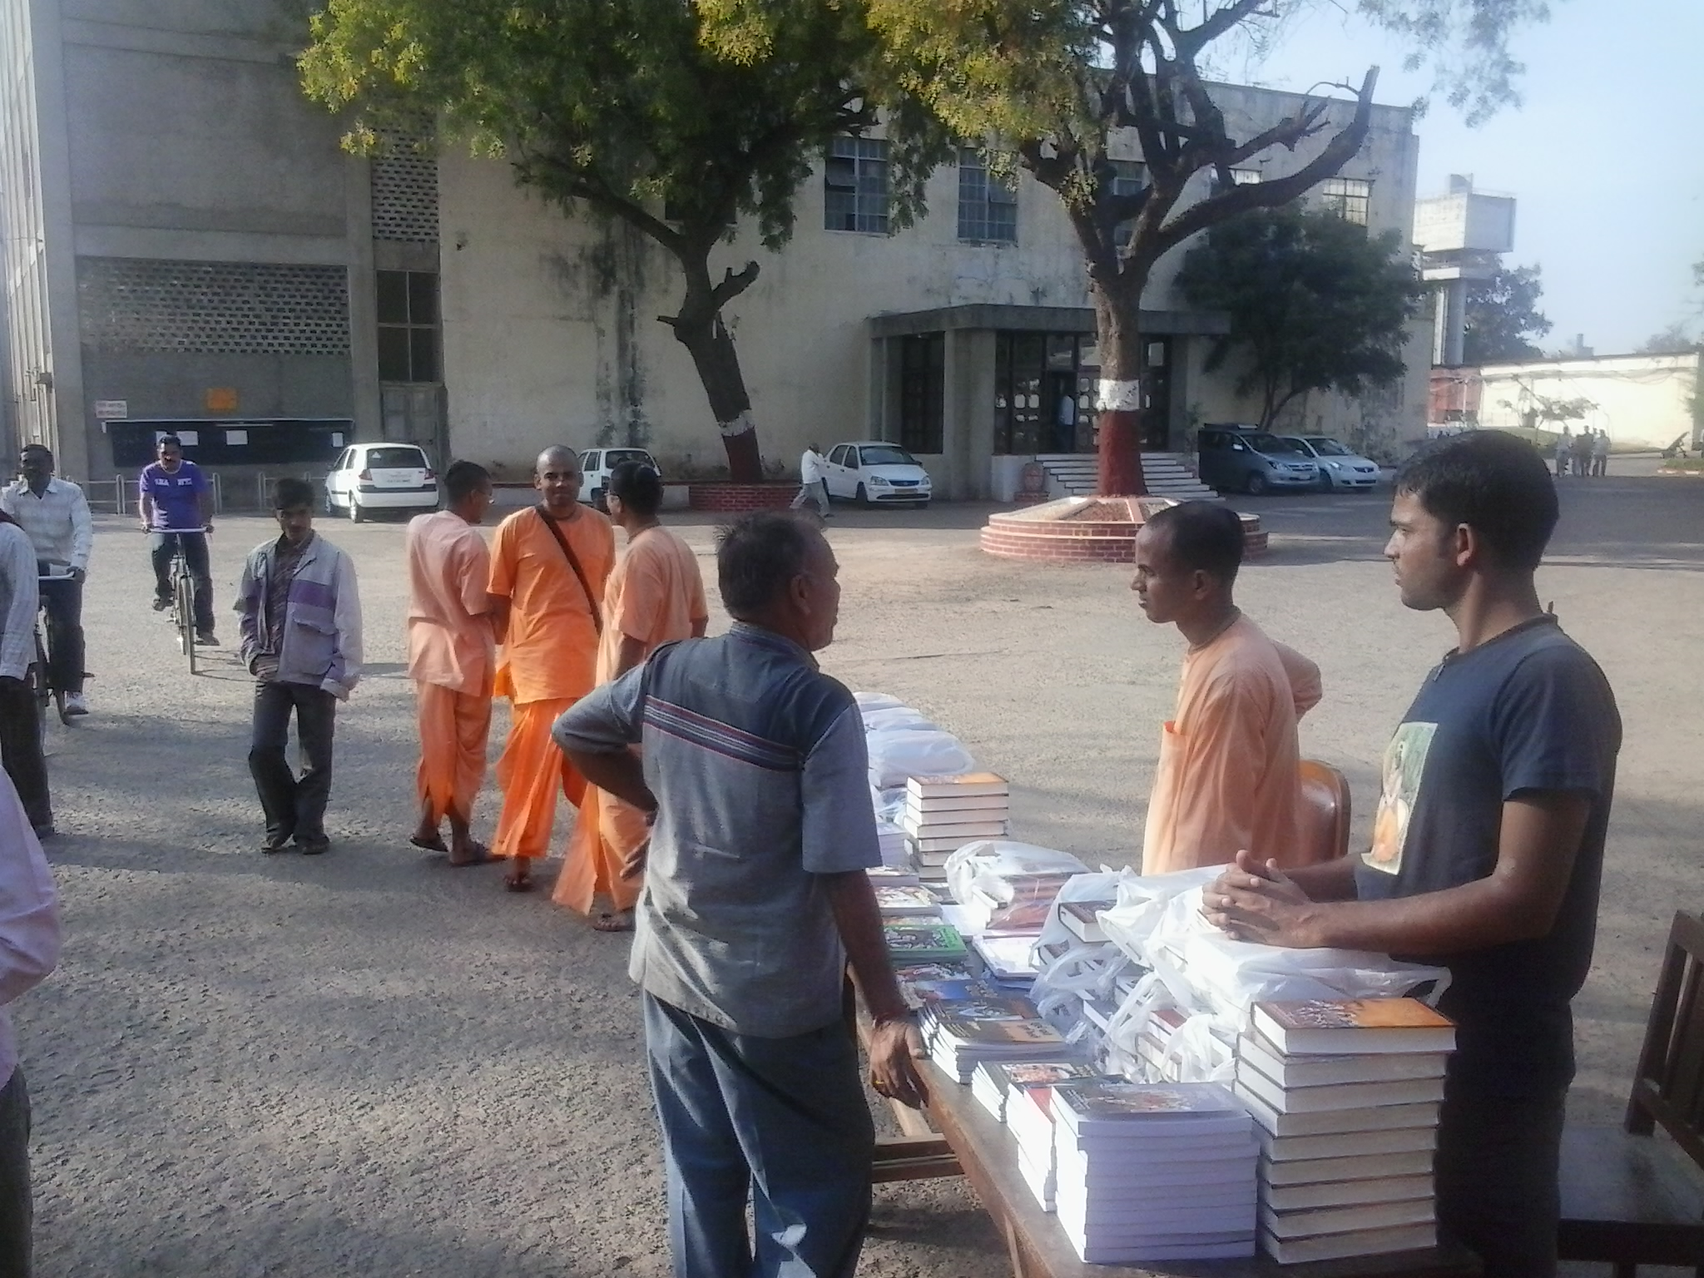

Slide 38
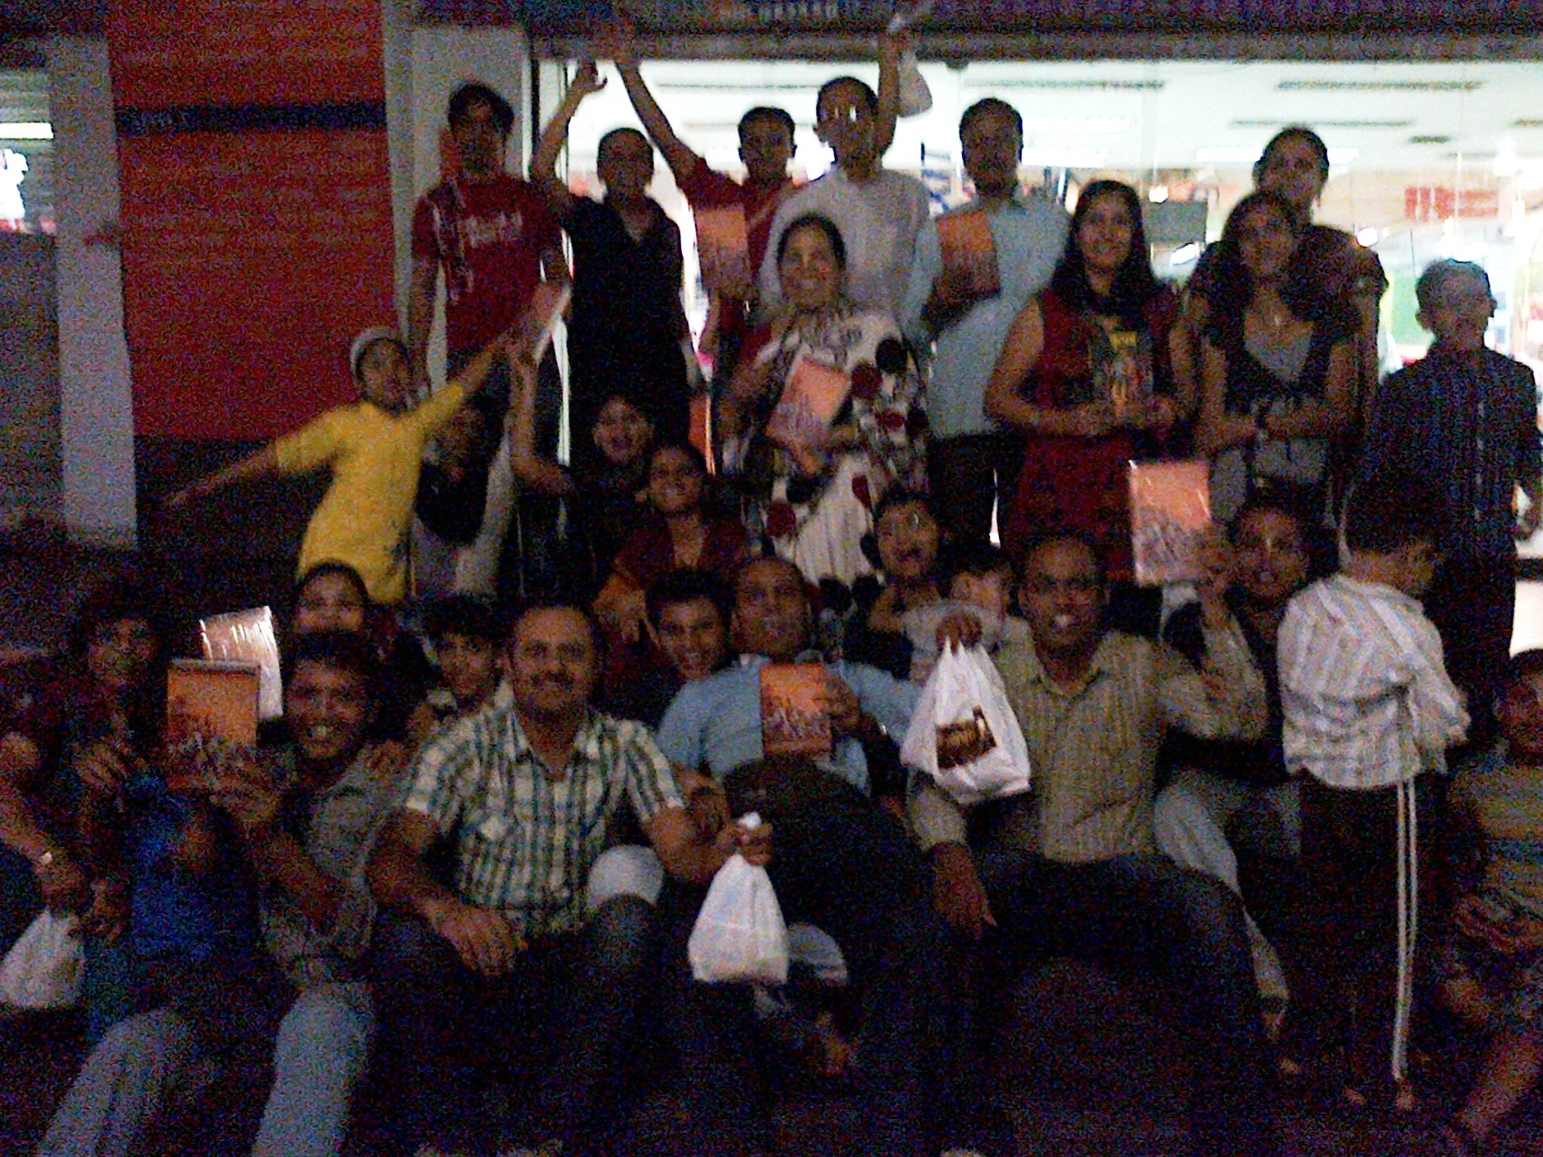

Slide 40
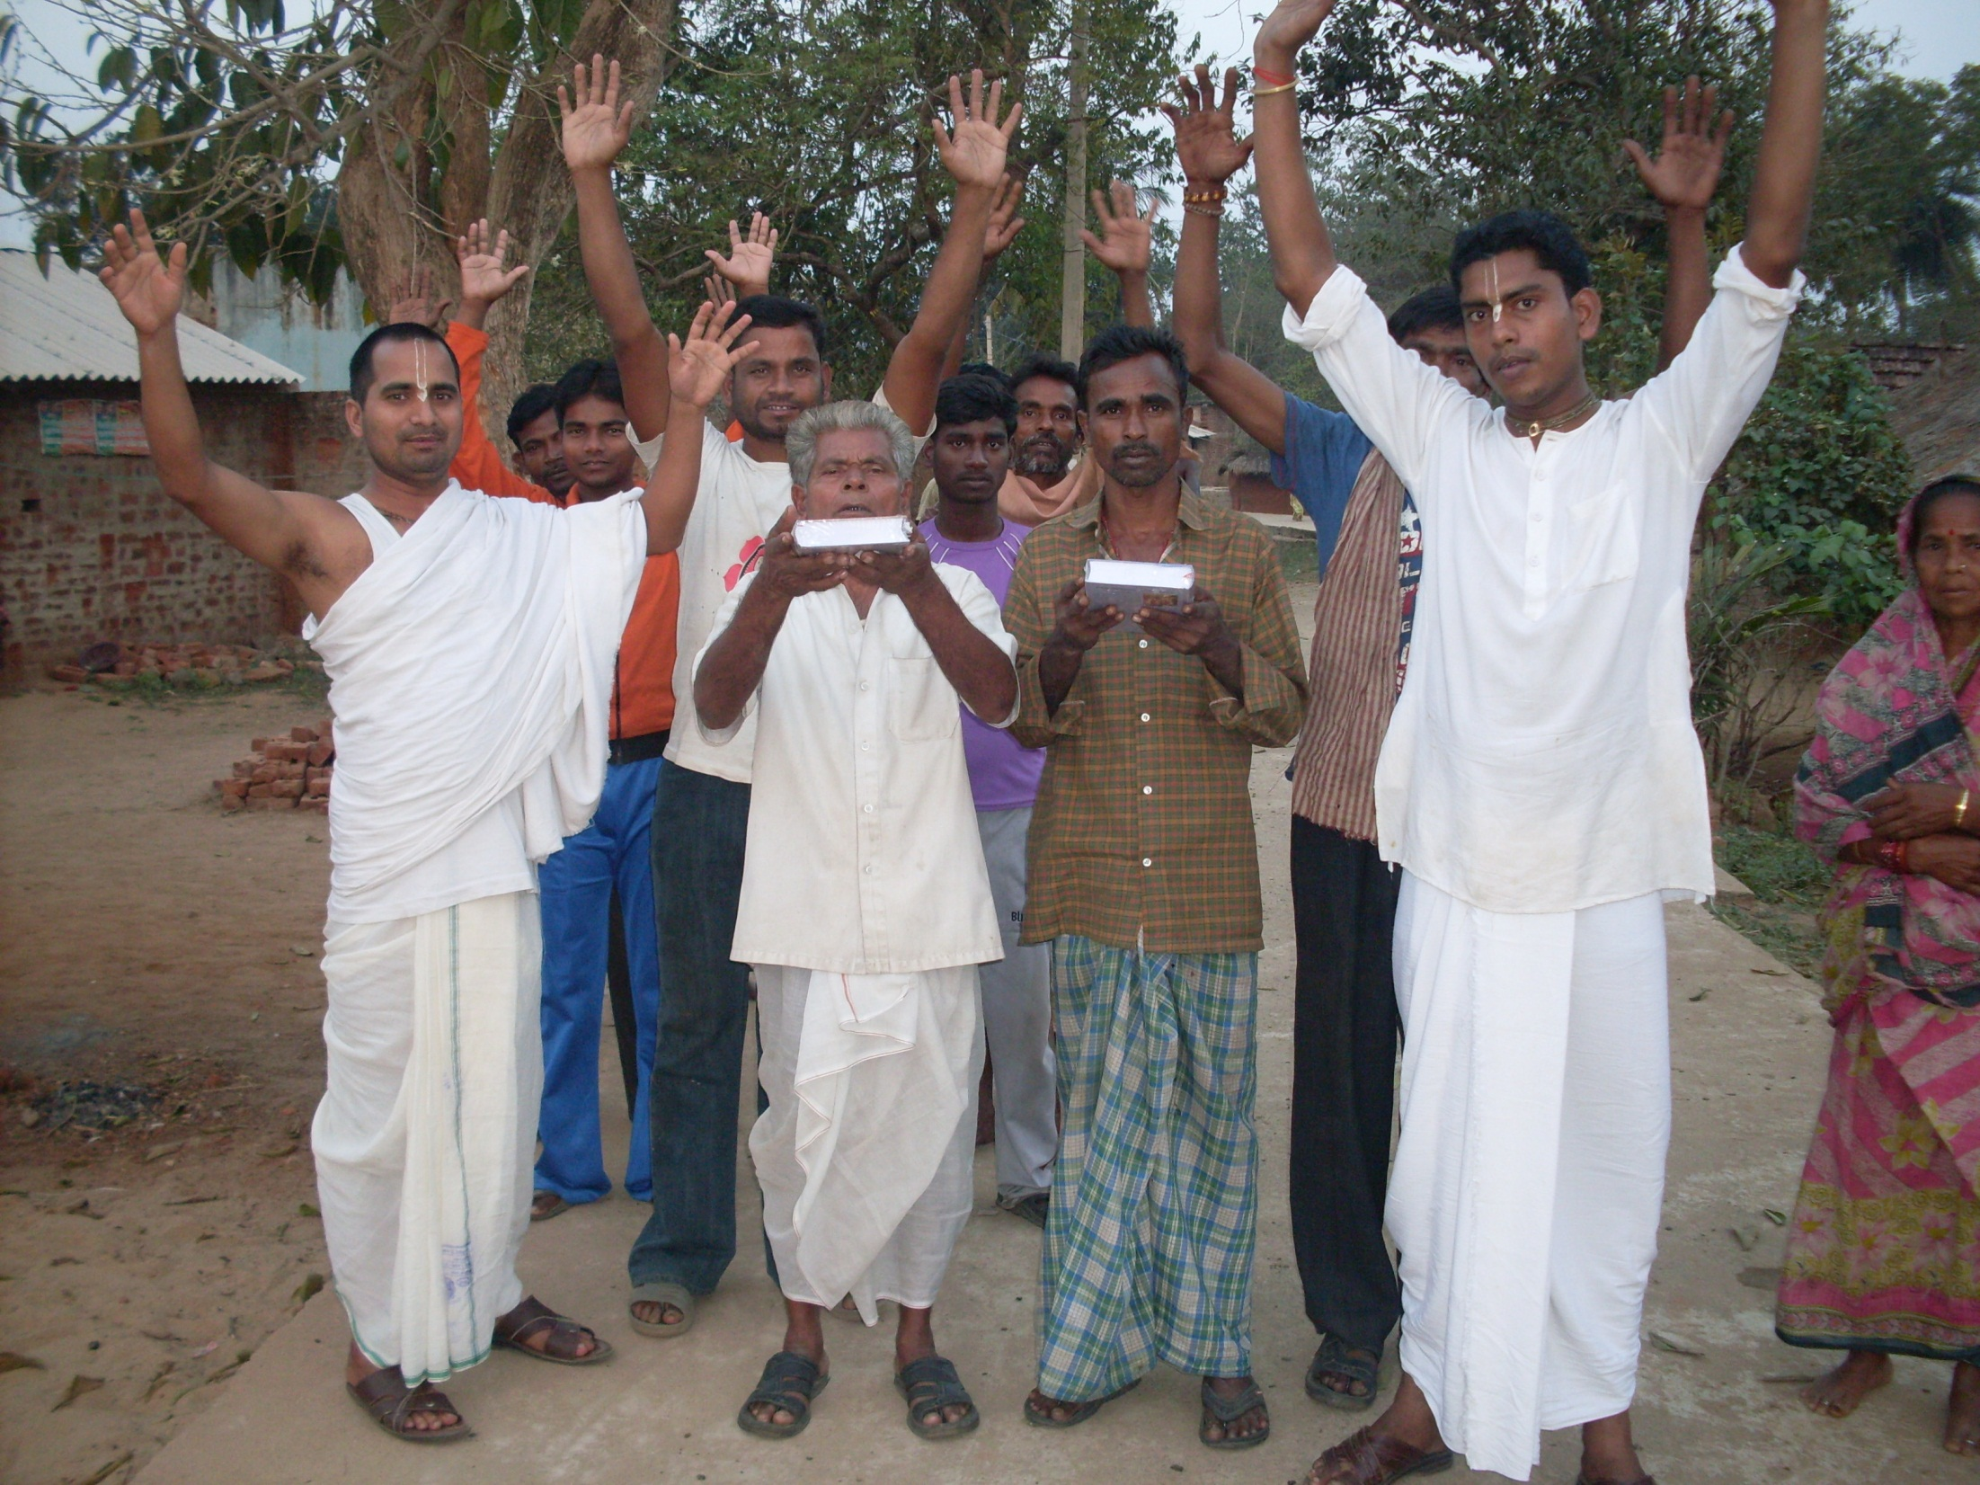

Slide 41
ISKCON TIME BOMB

Slide 42
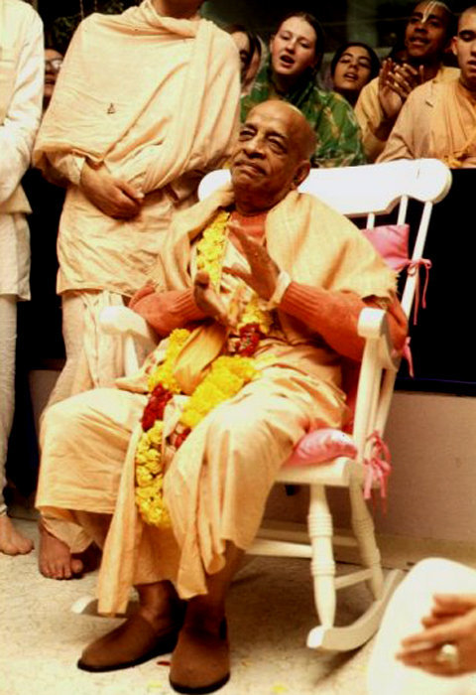
Thank you very much

